Slide 1
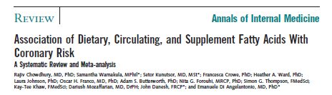
29.534

Slide 2
Results from Chowdhury et al. (from Abstract)
(RRs and 95% CIs for highest vs lowest category)
Fat type | Cohorts, diet | Cohorts, blood | Randomized trials
Saturated | RR = 1.02 ( 0.97-1.07) | RR = 1.06 (0.86-1.30)
Monounsat | RR = 0.99 (0.89-1.09) | RR = 1.06 (0.97-1.17)
N-6 polyunsat | RR = 1.01 (0.96-1.07) | RR = 0.94 (0.84-1.06) | RR = 0.89 (0.71-1.12)
N-3 polyunsat (long chain) | RR = 0.93 (0.84-1.02) | RR = 0.84 (0.63-1.11) | RR = 0.94 (0.86-1.03)
Trans | RR = 1.16 (1.06-1.27) | RR = 1.05 (0.76-1.44)
9.260

Slide 3
Conclusion from Chowdhury Abstract
“Current evidence does not clearly support cardiovascular guidelines that encourage high consumption of polyunsaturated fatty acids and low consumption of total saturated fats.”
(Chowdhury R. et al. Ann Intern Med 2014:160:398-406)

Slide 4


Butter is Back
March 25, 2014
Mark Bittman
Julia Child, goddess of fat, is beaming somewhere.
29.533

Slide 5
Strengths of Chowdhury et al.
See comments on Ann Intern Med website:
http://annals.org.ezp-prod1.hul.harvard.edu/article.aspx?articleid=1846638
Comprehensive look at multiple fats
Inclusion of cohort studies of diet and biomarkers and randomized trials
Based on “hard endpoints”
Consistent methods across dietary fats
9.261

Slide 6
Problems with Chowdhury et al.
See comments on Ann Intern Med website:
http://annals.org.ezp-prod1.hul.harvard.edu/article.aspx?articleid=1846638
Gross errors in data abstraction from original papers
Omission of important studies, especially on polyunsaturated fat
Omission of important bodies of evidence (e.g. feeding studies)
Lack of specific comparisons, and failure to acknowledge this
Misrepresentation of findings (especially long-chain N-3 fatty acids)
Failure to acknowledge other summaries based on primary data that had different conclusions
9.259

Slide 7
Types of Studies of CHD
Study Type | Strengths | Limitations
Ecological | Large numbers | Confounding
Feeding Studies | Control of diet and confounding | Surrogate outcomes
Cohort Studies | Clinical outcomes, better control of confounding | Potential remaining confounding
Randomized Trials | Control of confounding | Adherence to diet, costly
9.258

Slide 8
10-Year Coronary Incidence Per 10,000 Men
Incidence
(Keys 1980)
y=77+78x
P=0.73
east Finland
west Finland
Crevalcore
Rome railroad
Zutphen
Montegiorgio
Belgrade
Corfu
Zrenjanin
Ushibuka
Dalmatia
Slavonia
Velika Krsna
Tanushimaru
Crete
9.006
Keys, 1980

Slide 9
3000
E
east Finland
Y= 64+27X r = 0.39
2000
W
Y = 10-YEAR CORONARY INCIDENCE PER 10,000 MEN
West Finland
Italy 1
C
Holland
N
1000
M
Corfu
Italy 2
Belgrade, Yugoslavia 3
R
B
Italy 3
D
G
Z
Yugoslavia 4
Japan 1
Yugoslavia 2
S
Slavonia
J
V
T
Yugoslavia 1
Japan 2
K
Crete
0
0
10
20
30
40
X = % DIET CALORIES FROM TOTAL FATS
Ten-year incidence rate of coronary heart disease, by any diagnostic criterion, plotted against the percentage of dietary calories supplied by total fats. (Keys, 1980)
9.005

Slide 10
Keys
Serum chol = 1.35 (2 S - P) + 1.5 C^{0.5}
Hegsted
Serum chol = 2.16 S – 1.65 P + 0.176 C
9.008

Slide 11
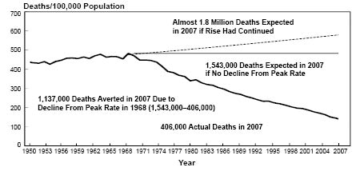
Age-adjusted Death Rates for Coronary Heart Disease, US 1950-2007
Deaths 100,000 Population
1,137,000 Deaths Averted in 2007 Due to Decline from Peak Rate in 1968 (1,543,000-406,000)
Year
Source: NHLBI website, Feb 2012
9.219

Slide 12
9.151

Slide 13
Estimated Sources of Calories in US Diet
Other carbs
Whole grain
Potatoes
Sat fat
Mono fat
Refined grain
Poly fat
Added sugar
Protein
Trans fat
29.340
(unpublished, compiled from NHANES)

Slide 14
Trans Fat
Refined Starch, Sugar
Saturated Fat
Carbohydrates
Whole Grains
Unsaturated Vegetable Fats
--High monounsaturated vegetable fats
--High polyunsaturated vegetable fats
29.536

