Slide 1
Types of fat and risk of CHD: Epidemiologic Evidence
Frank B. Hu M.D., Ph.D.
Professor of Nutrition and Epidemiology
Harvard School of Public Health
Professor of Medicine
Harvard Medical School and Brigham and Women’s Hospital
Director, Boston Obesity Research Center Epidemiology/Genetics Core

Slide 2
Types of Fat and Incidence of CHD (Nurses’ Health Study)
100
80
60
40
20
0
-20
-40
Trans
% Change in CHD
Sat
1%E 2%E 3%E 4%E 5%E
Mono
Poly
Hu FB, et al. New Engl J Med 1997

Slide 3
“Isocaloric substitution” of macronutrients and Risk of CHD
Sat -->Carbo (5%E)
Mono -->Carbo (5%E)
Poly --> Carbo (5%E)
Sat--> Mono (5%E)
Sat--> Poly (5%E)
Sat-->Unsat (5%E)
Trans--> Mono (2%E)
Trans --> Poly (2%E)
Trans --> Unsat (2%E)
-80
-60
-40
-20
0
20
40
60
80
Change in CHD Risk (%)
Hu FB, et al. New Engl J Med 1997

Slide 4
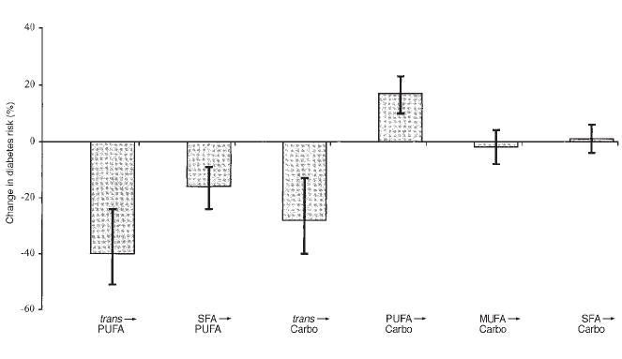
“Isocaloric substitution” of macronutrients and risk of type 2 diabetes
Salmeron J et al, 2001 AJCN

Slide 5
The relationship between P:S ratio and risk of CHD
RR=1
Median value 0.23 0.42 0.72
Deciles of polyunsaturated fat to 12:0-18:0 saturated fat ratio
Hu et al. AJCN 1999

Slide 6

11 American and European cohort studies were pooled. Criteria for inclusion:
Published follow-up study with ≥150 incident coronary events.
Availability of usual dietary intake.
A validation or repeatability study of the diet-assessment method used.
5249 coronary events and 2155 coronary deaths occurred among 344,696 persons
Within each study, HRs were calculated by using Cox proportional hazards regression with time in study as the time metric.
Jakobsen MU, et al. AJCN, 2009

Slide 7
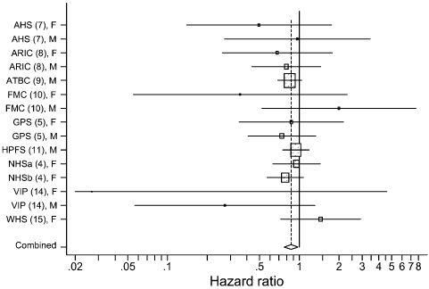
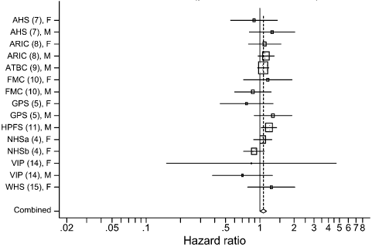
Coronary Events, per 5 E% increments
PUFAs for SFAs
CHs for SFAs
0.87 (0.77, 0.97),
P_{heterogeneity}=0.70
1.07 (1.01, 1.14), P_{heterogeneity}=0.51
The model included intake of MUFA, PUFA, trans-fatty acids, CHs, protein expressed as percentage, TEI, smoking, BMI, physical activity, highest attained educational level, alcohol intake, history of hypertension, and energy-adjusted quintiles of fiber intake (g/d) and cholesterol intake (mg/d)
Jakobsen MU, et al. AJCN, 2009

Slide 8
Substitution effect (5% of energy) of carbohydrates for saturated fatty acids differs by Glycemic Index
Jakobsen MU, et al. AJCN, 2010

Slide 9
Major food sources of individual saturated fatty acids (% absolute intake)
Hu et al. AJCN 1999

Slide 10
Multivariate RRs of CHD According to Quintiles of Saturated Fat Intake
 | Q1 | Q2 | Q3 | Q4 | Q5 | P for trend
4:0-10:0 | 1.0 | 1.0 | 0.9 | 0.8 | 1.1 | 0.78
12:0+14:0 | 1.0 | 1.0 | 1.0 | 1.1 | 1.2 | 0.07
16:00 | 1.0 | 0.8 | 0.9 | 1.1 | 1.1 | 0.04
18:00 | 1.0 | 1.1 | 1.0 | 1.3 | 1.2 | 0.01
Sum of 12:0-18:0 | 1.0 | 0.9 | 0.9 | 1.1 | 1.2 | 0.03
Hu et al. AJCN 1999

Slide 11
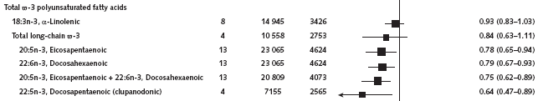
RRs for coronary outcomes in the prospective cohort studies of circulating omega-3 polyunsaturated fatty acids
Chowhury R, et al. Ann Intern Med 2014

Slide 12
Summary
In populations who consume a Western diet, the replacement of 1% of energy from SFAs with PUFAs is associated with a 2-3% reduction in CHD incidence.
No clear benefit of substituting carbohydrates for SFAs, but there might be a benefit if the carb has a low GI.
Insufficient evidence on the effect on CHD risk of replacing SFAs with MUFAs, but the available data on MUFAs are confounded by the food sources of MUFAs (eg, dairy and meats) in Western dietary patterns.
Dietary recommendations should be food-based: replacing high SFA foods such as red/processed meats and butter with vegetable oils (high in MUFA/PUFA), nuts/seeds, legumes, and whole grains

